Slide 1

DEPARTMENT OF COMPUTER SCIENCE & ENGINEERING(DATA SCIENCE)
“E-waste Recycler Gap”
COURSE NAME : MINI PROJECT
COURSE CODE:22CDS48
Presentation by,
NAME :Shreya B N
Thupalli Dharani
USN: 1NH24CD151
1NH24CD174
Under the Guidance of ,
Guide Name: Ms ANJU K
Designation-Professor

Slide 2
Agenda
Introduction
Literature survey / Existing system
Limitations of Existing System
Problem Definition
Proposed system
Objectives
Design modules
Algorithm / Flow chart
Conclusion

Slide 3
Introduction
Discarded electronics (phones, laptops, TVs, batteries) at end-of-life; India is the 3rd largest generator (~13.97 lakh MT in FY 2024–25, Central Pollution Control Board).
Bengaluru generates ~92,000 tonnes annually, with ~30% mismanaged (Karnataka State Pollution Control Board).
Extended Producer Responsibility mandates manufacturers to collect and recycle a percentage of sold products.
Recycle Gap Score indicates recycling stress; higher score = poorer infrastructure, often due to capacity overload.
Supports E-Waste Management Rules 2022 compliance and helps companies (Dell, Philips) and regulators optimize collection and infrastructure planning.

Slide 4
Literature survey / Existing systems
Author & Year | Title / Approach | Key Finding | Research Gap Identified
Joseph N., Philip L., Bhattacharyya T. 2021 — Waste Management, Elsevier | Gap between formal & informal e-waste recycling facilities in India Facility-level comparative study | Informal sector dominates due to lower costs & wider reach; formal sector lacks raw e-waste supply | No digital bridge between informal collectors and formal recyclers; no ward-level collection data
Sengupta D., Ilankoon I.M.S.K., et al. 2022 — Minerals Engineering, Elsevier | Circular economy & household e-waste management — integration of formal & informal sectors Modified EPR model | India's formal recycling rate below 10%; proposed EPR model to register kabadiwalas under SPCBs | Model is theoretical; no implementation platform or citizen-facing interface proposed
Singh S., Dasgupta M.S., Routroy S. 2022 — Waste Management & Research, SAGE | Evaluation of sustainable e-waste collection methods for urban & rural India Multi-method comparative analysis | Door-to-door collection most effective for urban India; formal take-back poorly adopted | No technology-enabled scheduling or route optimisation system proposed for urban wards
Bagwan W.A. 2023 — Waste Management Bulletin, ScienceDirect | E-waste generation & ARIMA forecasting of processing capacity in Maharashtra till 2030 Time-series ARIMA forecasting | Maharashtra e-waste processing capacity growing at 6.86% annually; formal sector lags informal in collection | State-level forecast only; no city-wise, ward-level or real-time collection tracking system
Singh S., Yadav V., Routroy S., Dasgupta M.S. 2025 — J. Material Cycles & Waste Mgmt, Springer | Risk propagation in e-waste collection system using Bayesian Networks Probabilistic risk modelling | Data inconsistency in collection records (location, quantity, date) is the top propagating risk | No real-time data capture system or citizen-facing collection platform proposed

Slide 5
Limitations
The system relies on user-reported e-waste data, which may be inaccurate or incomplete.
Informal collectors may not adopt the platform due to low digital literacy.
Ward-level data from BBMP is inconsistent and not always publicly available.
The model does not account for transboundary or illegally imported e-waste flows.
Real-time collection tracking depends on continuous internet connectivity, which may be unreliable in certain urban pockets.

Slide 6
Problem Definition
Bengaluru generates ~92,000 tonnes of e-waste annually (Karnataka State Pollution Control Board), with ~30% mismanaged and 20% handled informally, while recyclers are concentrated in industrial zones, leaving many residential wards underserved and without data-driven prioritisation. Under E-Waste Management Rules 2022, companies like Dell and Philips must meet 60–80% recycling targets, but lack of ward-level insights leads to inefficient collection, missed compliance, and avoidable fines.

Slide 7
Objectives
Map and monitor ward-level e-waste generation hotspots across Bengaluru using spatial data to enable targeted collection planning.
Bridge the gap between citizens, informal collectors, and formal recyclers through a digital platform that streamlines e-waste pickup and disposal.
Forecast e-waste generation trends at the city and ward level to support data-driven policy decisions and recycling infrastructure planning.

Slide 8
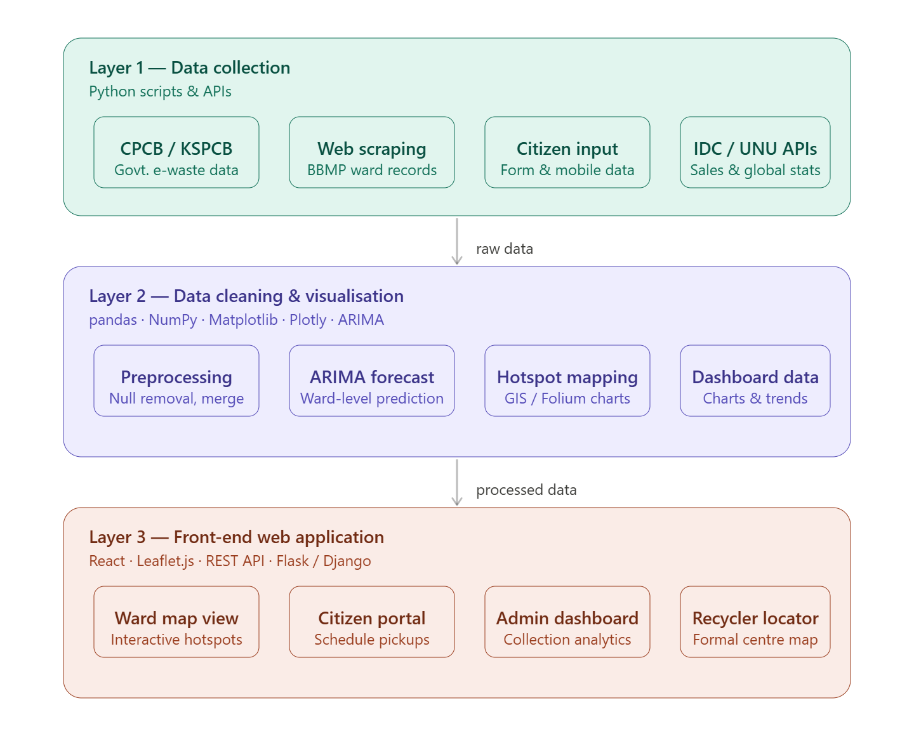
Design Modules

Slide 9
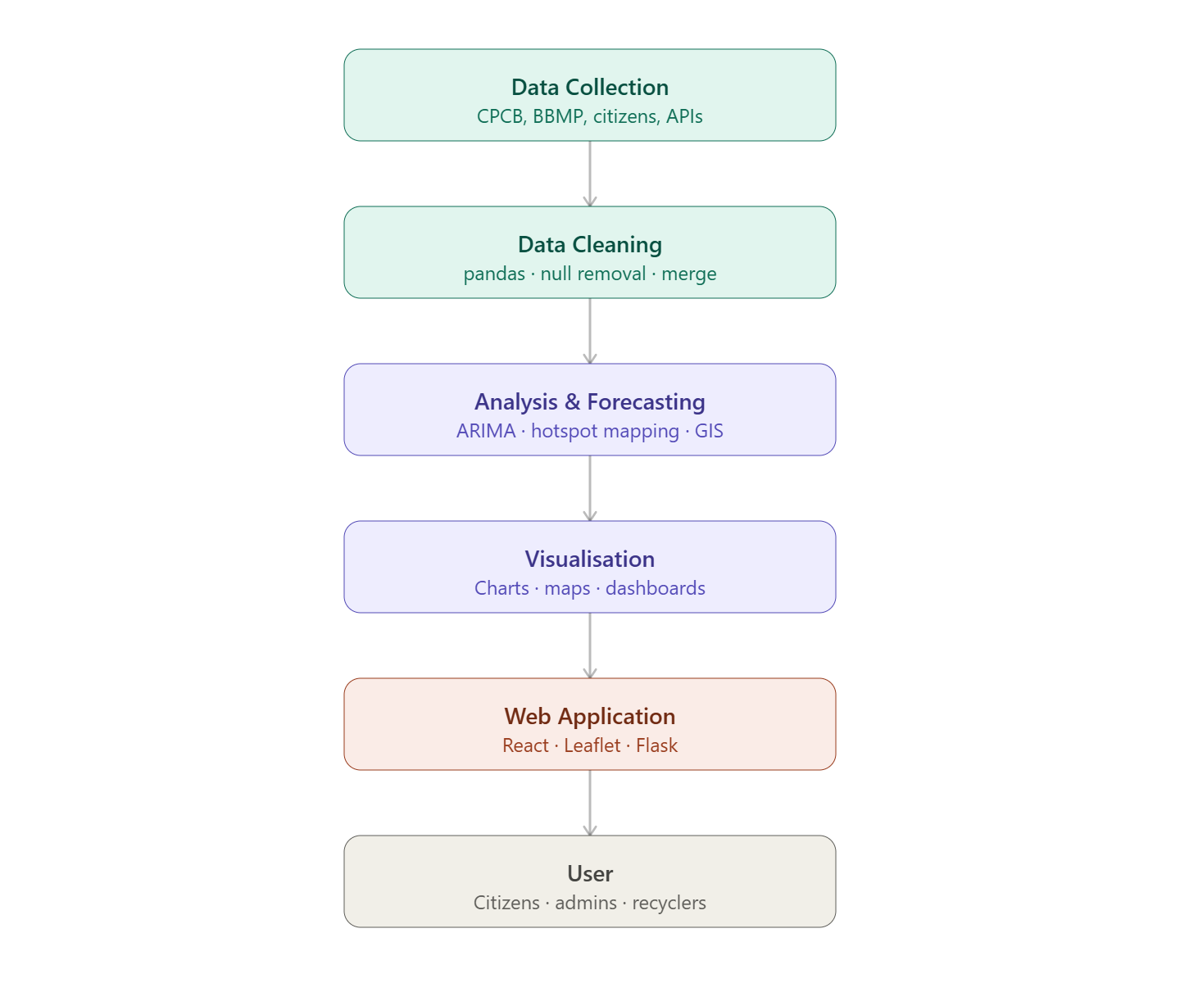
Algorithm / Flowchart

Slide 10
Algorithm / Flowchart
Initialize: Define environment seeds and global e-waste anchors.
Iterate: For every ward and year, simulate e-waste metrics.
Evaluate: Calculate the "Gap Score" to determine infrastructure stress.
Export: Produce structured datasets (CSV/XLSX) and visual diagnostics (Power BI).
Secure: Generate metadata and a SHA256 provenance hash for data integrity.

Slide 11
Conclusion
This project builds a scalable ward-level e-waste analytics system for 20 wards in Bengaluru (2024–2026), using a Recycle Gap Score to identify under-served areas based on discard rate, capacity overload, and recycler scarcity.
The system is production-ready, allowing real data from Karnataka State Pollution Control Board or Bruhat Bengaluru Mahanagara Palike to be integrated easily.
It supports companies like Dell and Philips in optimizing EPR compliance and helps regulators plan recycler expansion, with future scope for expansion to other cities, integration with Central Pollution Control Board data, and a citizen-facing app.

Slide 12
References
[1] Joseph N., Philip L., Bhattacharyya T. (2021). "Understanding the Gap Between Formal and Informal E-Waste Recycling Facilities in India." Waste Management, Elsevier. https://doi.org/10.1016/j.wasman.2021.02.045
[2] Bagwan W.A. (2023). "Electronic Waste Generation and Management Scenario of India, and ARIMA Forecasting of E-Waste Processing Capacity of Maharashtra State till 2030." Waste Management Bulletin,ScienceDirect.
https://www.sciencedirect.com/science/article/pii/S0892687522002710
[3] Arya U., Goel S., Chaturvedi A. (2023). "Design, Adoption and Implementation of Electronic Waste Policies in India." Environmental Science & Pollution Research, Springer / PMC.
https://doi.org/10.1007/s11356-023-26774-0
[4] Schloms L., Lübben V., Finger V. (2025). "Electronic Waste Management in Northern India: A Regional Case Study of Chandigarh." Journal of Material Cycles and Waste Management, Springer Nature.
https://link.springer.com/article/10.1007/s10163-025-02194-8

Slide 13
[5] Puri S., Raka S., Raut S., Sadavarte S., Phadnis S. (2025). "The E-Waste Challenge in
India: A Study on Generation, Handling, and Impact." SSRN.
https://ssrn.com/abstract=5219208
[6] Sengupta D., Ilankoon I.M.S.K., Kang K.D., Chong M.N(2022). — Circular Economy and Household E-Waste Management in India: Integration of Formal and Informal Sectors
https://doi.org/10.1016/j.mineng.2022.107661
[7] Singh S., Dasgupta M.S., Routroy S.(2022) — Evaluation of Sustainable E-Waste Collection Method for Urban and Rural Region of India
https://doi.org/10.1177/0734242X211018512
[8] Dasgupta D., Majumder S., Adhikari J., Ghosh P., Purchase D., Garelick H., Debsarkar A., Chatterjee D.(2023) — Environmental Impact of E-Waste Management in Indian Microscale Informal Sectors
https://doi.org/10.1007/s11356-022-23700-7

Slide 14
Thank you
Queries ?

